Slide 1
Python Classes and Objects

Slide 2
Python Classes/Objects
Python is an object oriented programming language.
Almost everything in Python is an object, with its properties and methods.
A Class is like an object constructor, or a "blueprint" for creating objects.

Slide 3


Create a Class
To create a class, use the keyword class:
Create Object
Now we can use the class named MyClass to create objects:

Slide 4
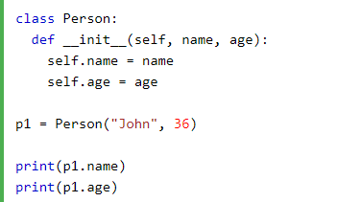
The __init__() Function
All classes have a function called __init__(), which is always executed when the class is being initiated.
Use the __init__() function to assign values to object properties, or other operations that are necessary to do when the object is being created:
The __init__() function is called automatically every time the class is being used to create a new object.

Slide 5
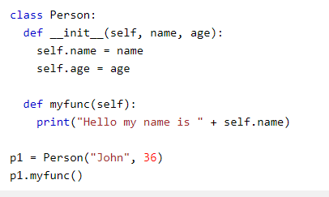
Object Methods
Objects can also contain methods. Methods in objects are functions that belong to the object.

Slide 6
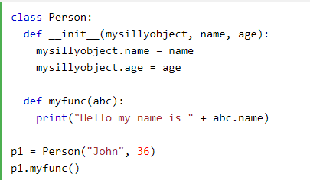
The self Parameter
The self parameter is a reference to the current instance of the class, and is used to access variables that belongs to the class.
It does not have to be named self , you can call it whatever you like, but it has to be the first parameter of any function in the class:

Slide 7



Modify Object Properties
You can modify properties on objects like this:
Delete Object Properties
You can delete properties on objects by using the del keyword:
Delete Objects
You can delete objects by using the del keyword:

Slide 8

The pass Statement
class definitions cannot be empty, but if you for some reason have a class definition with no content, put in the pass statement to avoid getting an error.

